Slide 1

Email Categorization Using Hadoop + Mahout
M.Tech BigData Project Presentation
Thakur Raghwendra • Ajay Krishnanand • Pradhuman Singh

Slide 2

The Email Overload Problem
📧 Volume Crisis
⚠️ Spam Threat
333 billion emails sent daily — manual sorting is impossible
45% of all emails are spam — phishing, scams, noise
⚡ Scalability Gap
Traditional tools fail at distributed, large-scale processing

Slide 3

Datasets Used
Dataset Collection & Organization
Collected email data from the SpamAssassin public corpus and internal labeled samples (important and spam).
Stored each email as a separate file, with labels derived from folder names.
Total dataset size: 1.5 lakh emails
Class Distribution
Important/Ham: 50k
Spam (internal): 30k
SpamAssassin corpus: 70k
Created a small test dataset (raw_sample) with 8 files for quick pipeline testing.

Slide 4


Technology Stack
Hadoop + HDFS
Node.js + Express
Ubuntu WSL2 + Bash
Distributed storage and processing
REST API for predictions
Development environment and automation scripts
MapReduce
Parallel text preprocessing
React + Vite
Dark-mode dashboard UI
Mahout + Naive Bayes
TF-IDF vectorisation and classification

Slide 5
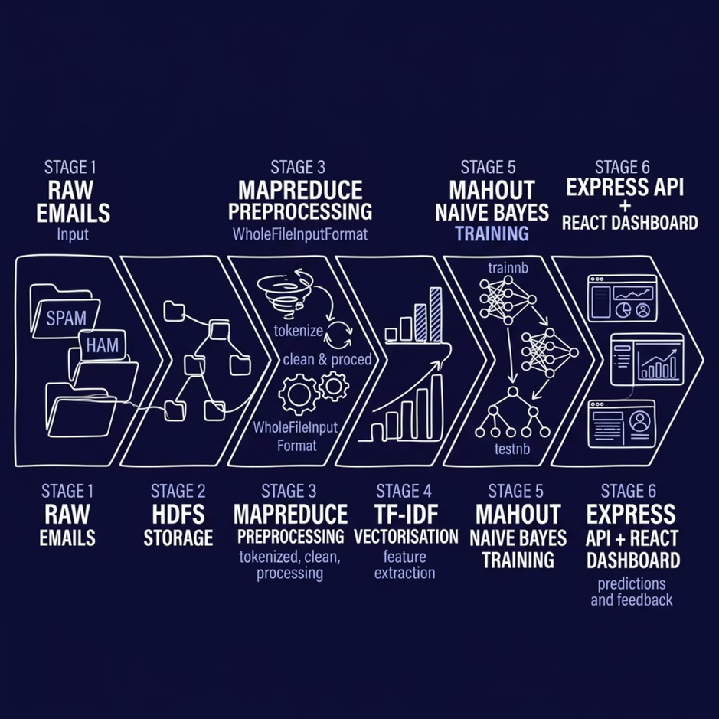
System Architecture
End-to-end pipeline — raw emails to classified predictions — fully automated and distributed.
Raw Emails → HDFS
MapReduce Preprocessing
TF-IDF + Mahout NB
Express API → React Dashboard

Slide 6
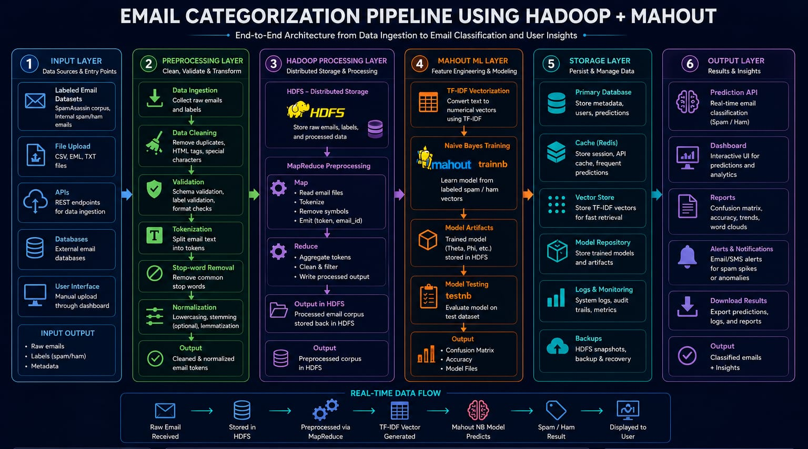

Slide 7

HDFS + MapReduce Preprocessing
HDFS LAYER
Distributed Storage
Emails uploaded to /email_project/raw
Labels inherited from folder names
Replication ensures fault tolerance
MAPREDUCE LAYER
Scalable Preprocessing
WholeFileInputFormat reads full emails
Tokenises text, removes symbols and stop-words
Output stored back in HDFS

Slide 8
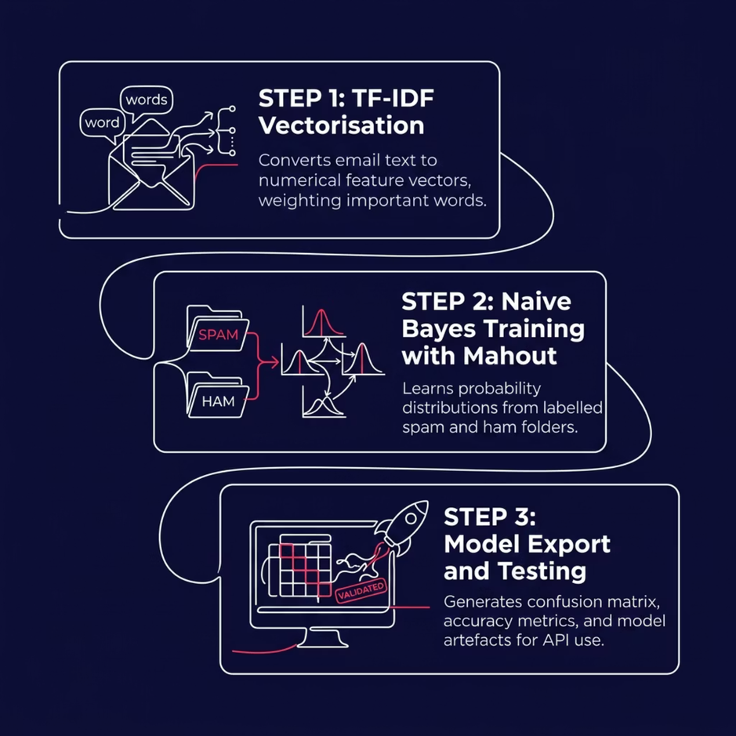

TF-IDF + Mahout Naive Bayes
How Classification Works
TF-IDF Vectorisation
Converts text into weighted numerical features
Naive Bayes Training
trainnb — learns from labelled spam / ham data
Model Testing
testnb — generates confusion matrix and accuracy

Slide 9
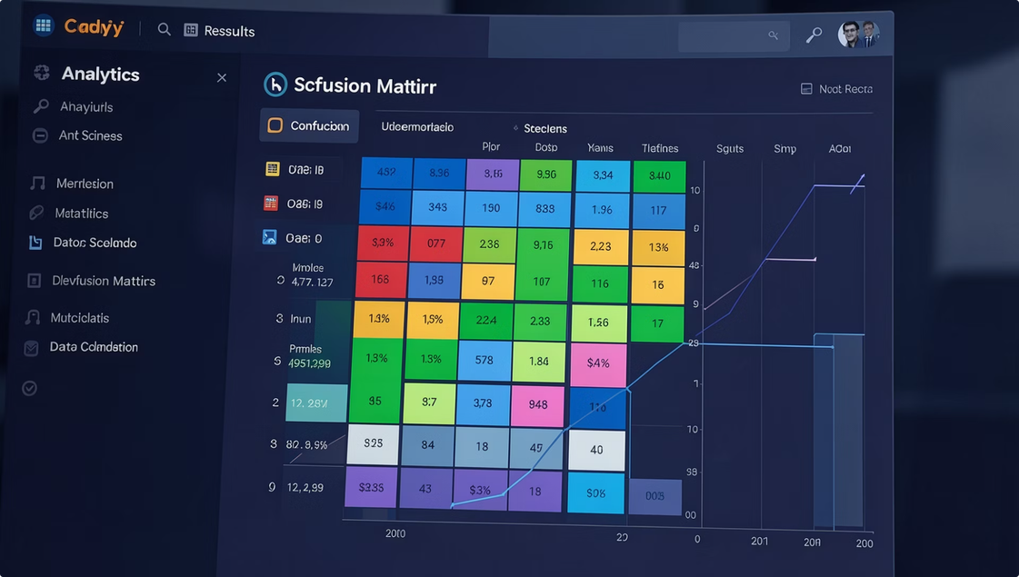
Results & Performance
Key Outcomes
✅ HDFS Integration
End-to-end distributed storage working
✅ Batch Predictions
CSV upload and download successful
✅ Live Feedback
Corrections persisted to HDFS
✅ Metrics Reports
Confusion matrix and accuracy generated
Note: Binary classification (Spam / Ham) validated on labelled folder dataset.

Slide 10


Limitations & Future Roadmap
Current Limitations
Binary classification only
Traditional ML — no deep learning
Limited dataset scale
Future Enhancements
Multi-class categorisation
Transformers and BERT-based NLP
Docker + Cloud deployment
Apache Spark integration

Slide 11

Thank You
Email Categorization Using Hadoop + Mahout

